Slide 1
RSA Approach for Securing the Cloud
Bernard Montel
Directeur Technique RSA France
Juillet 2010

Slide 2
Security is at the center of EMC’s private cloud strategy
Trusted
Control
Reliable
Secure
Flexible
Dynamic
On-demand
Efficient
Private
Cloud
Federation
Virtualization
Virtualized
Data Center
Cloud
Computing
Information
Security
Internal cloud
External cloud

Slide 3
The Journey to the Cloud and its Security Implications
Virtualize non critical systems
New attack surfaces needs to be locked down
  Introduce new platform and management components in IT ecosystem
Security policies need to centered on identity and information, not infrastructure
Compliance and security need visibility into the virtual infrastructure
Virtualize mission critical applications
  Dissociate application from IT physical infrastructure
Need new perimeters enforced within the virtual infrastructure aligned with policies
Security management is converging with Virtual infrastructure amanagement
Create internal clouds
  Make IT available as a service
  Convergence of IT admin roles (storage, network, system, V.I.)
Need evidence of compliance from cloud providers
Need multi-tenancy and isolation built in the cloud infrastructure
Expand to external clouds
  Externalize IT physical infrastructure
Information in physical infrastructure needs to be isolated from service providers admins
Need to federate identity and policies across clouds
Journey to the Cloud ⬄ Security Journey

Slide 4

Cloud’s Emerging Security Challenges
Defining Trusted Zones
Surpassing Physical Infrastructure Security
4
Notes:
4
1 – We will review the security threats and challenges we see emerging from the cloud
2 – I’ll introduce the Trusted Zones, a fundamental concept of our cloud security strategy
3 – We will see examples of how trusted zones in virtual infrastructures can surpass the level of security we currently have in Traditional IT infrastructures

Slide 5
Question
Does your IT security address the risks associated
with virtualization and private cloud before
they are implemented?
Question
Does your IT security address the risks associated
with virtualization and private cloud before
they are implemented?
Why is this bad?
Restricted potential value
Increased potential for data breaches
24%
43%
22%
11%
“Yes, in all cases”
“In some cases,
but there are gaps”
“No, security is brought in after the fact”
“The business moves ahead without security”
5
Source: Live EMC Forum pole conducted in 5 cities across N. America, 10/09
Notes:
What do you think these numbers mean <pause>
Well, in October of 2009 RSA spoke at the EMC luncheon keynotes. This gave us a wonderful opportunity to talk to thousands of you, our EMC customers in cities like Dallas, Toronto, New York City and Mexico City and we took full advantage. We conducted a live text pole of each audience to understand how you addressed security in the context of adopting virtualization and private cloud. <click>We asked you if your IT security addressed the risks associated with virtualization and private cloud before they are implemented and you know how you replied?
<click> Only 24% of you said that security was addressed proactively in all cases and 33% of you said that security is an afterthought or ignored altogether.
Survey data from Gartner conferences in late 2009 also finds that about 40% of virtualization deployment projects were undertaken without involving the information security team in the initial architecture and planning stages.
<click> Security as an afterthought is NEVER a good thing. Of course it can expose your organization to unforeseen risk, but perhaps more importantly we’ve found that organizations that fail to integrate security proactively into their virtualization and private cloud strategy deny themselves the opportunity to exploit the full value of virtualization buy limiting the scope of their deployments in an attempt to avoid risk. If you can relate to this, then you need to change if you aspire to deploy virtualization beyond just Test and Dev.

Slide 6























Adoption of Cloud Computing is Expanding the Enterprise Attack Surface
Remote Employees
Partners
Customers
IP Sent to
non trusted user
Stolen IP
App, DB or Encryption Key Hack
Fraud
Stolen Credentials
Channels
Channels
Channels
Partner Entry Points
Partner Entry Points
VPN
Endpoint
Network
Apps/DB
FS/CMS
Storage
Endpoint theft/loss
Network Leak
Email-IM-HTTP-FTP-etc.
Privileged
User Breach
Inappropriate
Access
Tapes lost or stolen
Contractors
Privileged Users
Privileged Users
Privileged Users
Privileged Users
Data Leak
Via USB/Print
Public Infrastructure Access Hack
Enterprise
Applications
Production
Database
File Server
Backup Tape
Internal Employees
Unintentional
Distribution
(Semi) Trusted User Misuse
Discarded disk exploited
Business
Analytics
Replica
SharePoint
eRoom, etc.
Disk
Arrays
Backup
Disk
Notes:
RSA: Securing Information Infrastructure
1-Jul-10
- Confidential -
6
Before we talk about surpassing current levels of security, we must be honest with ourselves and recognize that all the risks and threats we know and love, not only still exists, but with the cloud we are expanding them beyond our own IT infrastructure into the cloud.
In security jargon, we call this expanding the attack surface, which means that we are creating new ways of attacking IT assets.
Now you do not have to solely worry about your DBA accessing confidential data, you have also to worry about the DBA of your cloud provider!

Slide 7
Attacks are Now Targeting the Extended Enterprise
Public clouds increase corporations’ attack surface by exposing critical corporate applications to attackers
  Trojan attacks targeted at stealing login names and passwords are on the rise
  Corporate espionage is expanding driving attackers interest beyond financial institutions
60% of Fortune 500 contaminated by a Trojan over a one month period (August 2009)
Source: RSA Anti-Fraud Command Center
Notes:
The bad guys know that too well.
I’d like to share 2 statistics from the RSA Anti Fraud Command Center:
The number of Trojans, a form of malware designed to steal login names and passwords has been doubling every quarter in the past several quarters
When we investigate Trojan attacks, we found, just during the month of August, employees laptops from 300 of the Fortune 500 contaminated with such malware.
While these attacks are still largely focused on financial institutions, it is clear that the same methods we are currently using to online Identity theft for online banking will be required to protect the public cloud.

Slide 8


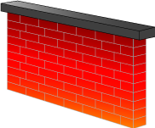
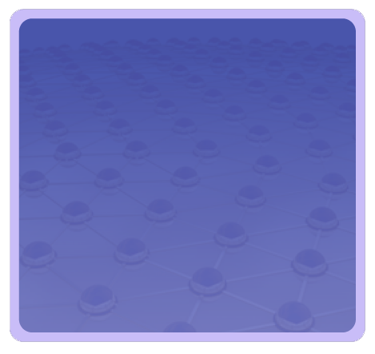










Traditional Computing: The Network Security Perimeter is Aligned with Policy Boundaries
Attackers
APP
APP
APP
APP
APP
APP
APP
APP
OS
OS
OS
OS
OS
OS
OS
OS
Identity
Infor-
mation
Identity
Infor-
mation
Physical Infrastructure
Physical Infrastructure
Enterprise #1
Enterprise #2
8
Notes:
The second security challenge posed by the cloud is a new one for the security industry. We are changing the boundaries of our security policies.
In traditional environments, there is a pretty good alignment between the scope of an organization security policy and the network security perimeter of that organization, with a reasonable amount of trust within that perimeter.

Slide 9


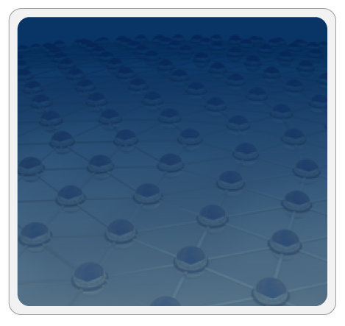


Private Clouds demand a Policy-aware
“Trusted Zone” for Data, VM and Identities
Attackers
Information
Information
APP
APP
Virtual Infrastructure
APP
APP
APP
APP
Virtual Infrastructure
APP
APP
OS
OS
OS
OS
OS
OS
OS
OS
Identity
Identity
Physical Infrastructure
Physical Infrastructure
Physical Infrastructure
Tenant #1
Cloud Provider
Tenant #2
9
Notes:
With cloud computing, your IT assets and your information are spreading beyond your own physical infrastructure into shared infrastructures in the cloud. Your data may be stored on a cloud provider storage that you do not control. Your CRM application may be running in the same infrastructure as your competitor’s.
In such an environment, a network security perimeter alone (OUTISDE IN) is not sufficient to control the scope of your policy. You need to build an additional perimeter around you data and your virtual applications that we call Trusted Zones (INSIDE OUT)

Slide 10
Cloud’s Emerging Security Challenges
Defining Trusted Zones
Surpassing Physical Infrastructure Security
10
Notes:
10
So what are these trusted zones?

Slide 11









Trusted Zones Key Capabilities
Federate identities with public clouds
Isolate infrastructure from Trojans and cybercriminals
Cybercrime intelligence
Identity federation
Strong authentication
APP
APP
Tenant #2
OS
OS
Virtual network security
Control and isolate VM in the virtual infrastructure
Virtual Infrastructure
Isolate information between tenants
Data loss prevention
APP
APP
Tenant #1
OS
OS
Virtual Infrastructure
Isolate information from cloud providers’ employees
Segregate and control user access
Encryption & key mgmt
Access Mgmt
Tokenization
Cloud Provider
Physical Infrastructure
Physical Infrastructure
Security Info. & Event Mgmt
Enable end to end view of security events and compliance across infrastructures
GRC

Slide 12

Creating “Trusted Zones” for cloud applications
Protect against cybercriminals
  Use cybercrime intelligence
  Implement strong authentication
Enforce trust policies
  VM-level:
    Group VMs into trusted zones
    Control VM provisioning policies
  Data level
    Avoid data leakage between tenants
    Control data in the cloud provider infrastructure
  Identity level: Manage user access within
  a trusted zone and across trusted zones
Managing policy compliance across physical,
virtual and cloud infrastructures
APP
APP
Tenant #2
OS
OS
Virtual Infrastructure
APP
APP
Tenant #1
OS
OS
Virtual Infrastructure
Cloud Provider
Physical Infrastructure
Physical Infrastructure
12
Notes:
Trusted zones have 3 core characteristics. The first one: They keep the bad guys i.e. the cyber criminals out

Slide 13



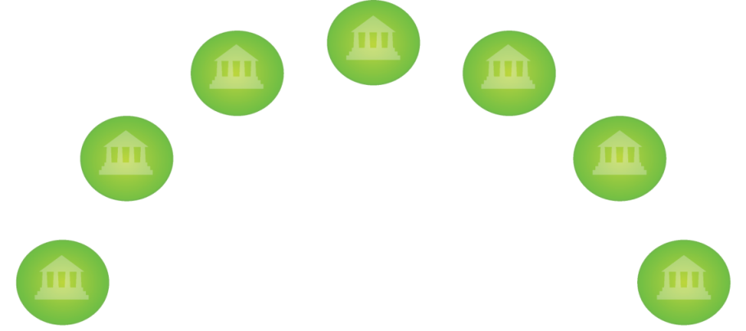


Provide Cybercrime Intelligence and Strong Authentication Based on Feeds from the Dark Cloud
Dark Cloud
Dark Cloud
Malware
Infection Point
Botnet
Herders
Trojan
Mothership
Hacker Forum
Discussion
eFraudNetwork
Corp 3
Corp 4
Corp 5
Stolen
Files
Repository
Stolen
Credentials
Database
Corp 2
Corp 6
Corp 1
Corp 7
Corporate
First level of defense: Cybercrime intelligence
Second level of defense: Strong authentication
Notes:
To keep the bad guys out, you need to understand how they operate. They are way ahead of us in term of adopting the cloud for business advantage. They have built a complete economy in the cloud; we call it the dark cloud.
Being able to gain knowledge from the dark cloud in order to dynamically adapt our defense based on the risk posed by cybercriminals is critical to protecting the corporate cloud.
This is about protecting the corporate cloud using the principles that RSA uses today with eFraudNetwork and adaptive authentication to protect financial institution and online banking customers: Clearly, password alone is not an adequate form of authentication in the cloud, we need to adapt methods of authentication based on the risks from the dark cloud.
13

Slide 14
Creating “Trusted Zones”
Protect against cybercriminals
  Use cybercrime intelligence
  Implement strong authentication
Enforce trust policies
  VM-level:
    Group VMs into trusted zones
    Control VM provisioning policies
  Data level
    Avoid data leakage between tenants
    Control data in the cloud provider infrastructure
  Identity level: Manage user access within
  a trusted zone and across trusted zones
Managing policy compliance across physical,
virtual and cloud infrastructures
APP
APP
Tenant #2
OS
OS
Virtual Infrastructure
APP
APP
Tenant #1
OS
OS
Virtual Infrastructure
Cloud Provider
Physical Infrastructure
Physical Infrastructure
14
Notes:
The second and most innovative characteristic of the trusted zone is how we are EMBEDDING security controls in the infrastructure in order to make the virtual and cloud infrastructure security policy aware and to make sure that the identities, the applications and data remains within the boundary of the security policy. For instance, in order to hide corporate data from the cloud provider sysadmin, we are providing the technology required to encrypt the data on cloud provider’s infrastructure while the encryption key securely remains on the enterprise infrastructure.
We are also working with VMware to control the movement of VM and sensitive data within a shared virtual infrastructure.

Slide 15

Virtualization Enables More Effective Security by Pushing Enforcement Down the Stack
Today most security is enforced by the OS and application stack making it ineffective, inconsistent and complex
vApp and VM layer
APP
APP
APP
APP
OS
OS
OS
OS
Pushing information security enforcement in the virtualization and cloud infrastructure ensures consistency, simplifies security management and enables customers to surpass the levels of security possible in today’s physical infrastructures
Virtual and cloud
infrastructure
Physical infrastructure
Notes:
We see this, as an opportunity to revolutionize security and to build IT infrastructures which are much more secured by design than current ones.
Today most security is enforced as an add-on to the OS or the application, making it ineffective, inconsistent and complex. Pushing information security enforcement in the virtualization and cloud infrastructure ensures consistency, simplifies security management and enables customers to surpass the levels of security possible in today’s physical infrastructures by making security SEAMLESS.
Let me show you a couple of example of this vision at work
15

Slide 16

VMware vShield Zones and RSA DLP:
Building a Content-Aware Trusted Zone
Virtual Infrastructure
Overview
VMware vShield Zones provides isolation between groups of VMs in the virtual infrastructure
Leverages the capabilities of vShield Zones to deploy DLP as a virtual application monitoring data traversing virtual networks
Uses a centrally managed policies and enforcement controls to prevent data loss in the virtual datacenter
Customer Benefits
Pervasive protection
Persistent protection
Improved scalability
VMware vShield zones
APP
APP
APP
APP
APP
APP
APP
APP
OS
OS
OS
OS
OS
OS
OS
OS
DLP
DLP
DLP
DLP
VMware VSphere
Physical Infrastructure
16
Notes:
The most advanced implementation of trusted zones in the integration between VMware vShield Zones and RSA DLP. This integration was demonstrated earlier this year at the RSA Conference.
vShield Zones is a technology from VMware (issued from the Bluelane acquisition) that acts as a virtual firewall between virtual machines. RSA has worked with VMware to make this technology content aware so that the virtual infrastructure can defines zones based on the Data Loss Prevention policies that govern sensitive data.
With this architecture, you can detect and block sensitive data directly in the virtual infrastructure before it even reaches the physical network.
16

Slide 17



Proof of Concept: RSA Data Loss Prevention with EMC Atmos
Concept demonstrated at EMC World 2009
Atmos metadata update based on DLP policy
Sensitive data never leaves customer sites or is only sent to trusted external cloud sites
Build content-aware private storage clouds
EMC Atmos
Federate data securely
Client App
Store data
EMC Atmos Online
Scan data
Update metadata
Internal storage Cloud
DLP
External Storage Cloud
Notes:
A similar concept was demonstrated with EMC Atmos Cloud Storage. We have made EMC Atmos content aware so that Atmos can decide on which physical infrastructure it stores data based on DLP policies.
With this integration, you can set policies in Atmos that prevent sensitive data from being stored on external Atmos infrastructure or that keep employee information in the country of origin of the employee in accordance with European privacy laws. We are putting borders in a borderless cloud.
There is no way this level of integration between security and IT infrastructure could be achieved with current IT architecture.
17

Slide 18
Creating “Trusted Zones”
Protect against cybercriminals
  Use cybercrime intelligence
  Implement strong authentication
Enforce trust policies
  VM-level:
    Group VMs into trusted zones
    Control VM provisioning policies
  Data level
    Avoid data leakage between tenants
    Control data in the cloud provider infrastructure
  Identity level: Manage user access within
  a trusted zone and across trusted zones
Managing policy compliance across physical,
virtual and cloud infrastructures
APP
APP
Tenant #2
OS
OS
Virtual Infrastructure
APP
APP
Tenant #1
OS
OS
Virtual Infrastructure
Cloud Provider
Physical Infrastructure
Physical Infrastructure
18
Notes:
To talk about the third and final characteristic of the trusted zone, I would like to quote our 40th president: “Trust but verify”. We are building in our trusted zones the ability to manage compliance and monitor security events across the physical and virtual infrastructures.

Slide 19
Monitoring and Managing Corporate Policy Compliance
Across virtual, physical, internal and external infrastructures
Virtual infrastructure management
VMware
vCenter
APP
APP
Tenant #2
OS
OS
Virtual Infrastructure
GRC
RSA
enVision
APP
APP
Tenant #1
End-to-end compliance reporting
End-to-end security event management
OS
OS
Virtual Infrastructure
EMC
IONIX
Cloud Provider
Security configuration and vulnerability management for physical and virtual infrastructures
Physical Infrastructure

Slide 20
Cloud’s Emerging Security Challenges
Defining Trusted Zones
Surpassing Physical Infrastructure Security
20
Notes:
20
To conclude this part of the presentation, I want to show you how these concepts come together in a solution that we announced yesterday for securing virtual desktops and how virtual desktops can get us higher level of security than their physical counterpart.

Slide 21
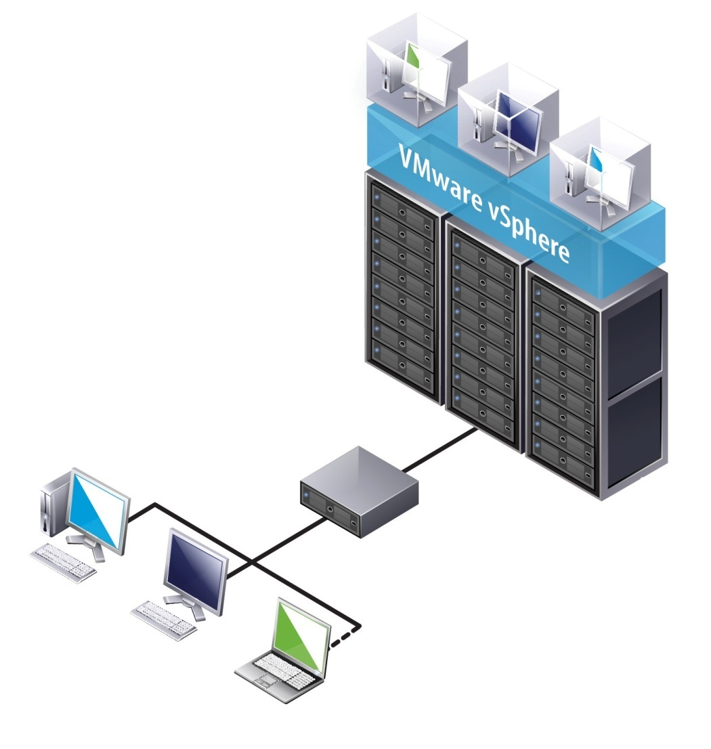
Surpassing Physical Security in Action: Virtual Desktop
Hosted virtual desktops are isolated from the dark cloud contamination by the enterprise perimeter
RSA Data Loss Prevention Endpoint prevents data loss at the virtual desktop
EMC IONIX ensures a secure configuration and patch level for all virtual desktops
RSA SecurID strong authentication for user access to virtual desktops
RSA SecurID strong authentication for administrative access to ESX
VMware View Manager
RSA enVision event monitoring and a centralized dashboard
21
Notes:
21
RSA Data Security System Briefing
1-Jul-10
- Confidential -
21
If you know any IT desktop administrator, they will tell you that their worst security nightmare is you, me and all our fellow end-users. We constantly change our desktop configuration add rogue programs, browse the Internet from our hotel rooms outside the corporate control and get infected with trojans and malware.
By design Virtual desktop infrastructures solve that problem by providing central control over desktop images, making it much easier to control desktop images and to monitor desktop usage.
On top of it, in the solution we announced yesterday, we are creating a trusted zone around virtual desktop by adding RSA DLP to ensure security of data in use, we are integrating with RSA SecurID for 2-factor authentication prior to any access to a virtual desktop from within or outside the network perimeter. We also providing integration with IONIX Server Configuration Manager to ensure all desktops have secure configuration and security patches and integration with RSA enVision to monitor the overall compliance of the desktop environment.
Overall such a solution provides an easy to manage architecture with unique security characteristics that you cannot get with physical desktop deployments

Slide 22

RSA is Uniquely Positioned to be the Leader in Securing the Cloud
Securing the virtual datacenter
Federation between internal and external clouds
Security-aware cloud infrastructures
Securing the private cloud
Strong authentication
Access management
Identity protection
Cybercrime monitoring
Securing the public cloud
Delivering RSA products as cloud services
Hosted by RSA, e.g., Adaptive Authentication, eFraudNetwork
Delivered by MSSP or other cloud providers
Notes:
I ‘d like to wrap up my part by summarizing how we RSA is going to market with these concepts.
First and foremost: Securing the Private Cloud. We are working with EMC and VMware to build security in the private cloud and in the next generation data centers.
We also see opportunities for apply our cybercrime intelligence capabilities and strong authentication to securing the public cloud.
Finally, we are already providing security as a cloud service with our authentication and fraud intelligence offerings. We are also an arm dealer and many Manage Security Service and cloud Providers are offering our technology as part of their cloud offering.
22

Slide 23
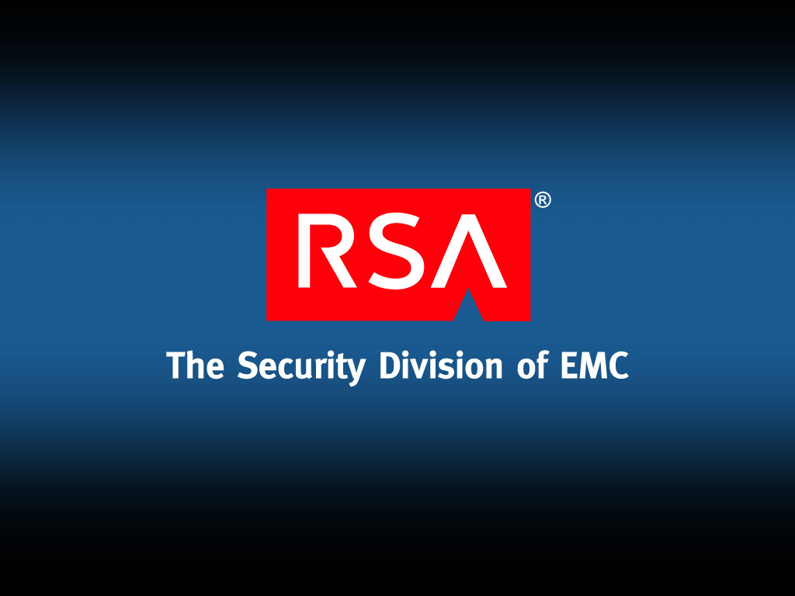
Thank you!

