Slide 1
Cloud – Risques ou Opportunités
Luis Delabarre – Solutions Architect

Slide 2





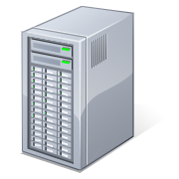





Cloud – Nouvel Eco système
Browser Client
Datacenter Architecture
Public
Cloud
Private
Cloud
Browser
Local
Storage
Web Server
Software as a Service
High
Performance
Computing
APP
APP
APP
Web
Analytics
Finance
Medical
Application API’s – AJAX
Platform as a Service
File System – BigTable
Development,
Administration,
Management tools
Runtime &
Data Management
Engine
Security & User
Management
Services
Network + Storage
Infrastructure as a Service
Database
Files
Hypervisor

Slide 3

Des menaces croissantes
Mariposa data-stealing botnet uncovered in more than 50% of Fortune 1000
March 2010
More than 100 companies targeted by Google hackers
January 2010
89% of enterprise security breaches not reported
RSA Survey
56% of tested enterprises have active data-stealing malware
Trend Micro Research
3
Notes:
Just how extensive is the threat to ENT today?
While consumer and small business theft dominate the headlines, with few exceptions – such as Google – ENT breaches go largely unreported unless forced by regulatory compliance.
But the same sophistication and determination we see in consumer theft is clearly at work behind the scenes.
Why are these incidents on the rise, despite best efforts by ENT & Vendors? What is the ENT facing today?
(go to next slide)
(Background/Detail)
The reality is that enterprises are actively getting infiltrated and compromised with bot infections.
In January of this year, the prevalent ZeuS bot was reported to have compromised 2500 companies. This month, Mariposa, another prominent bot has been reported to have infiltrated more than half of the Fortune 1000 companies.
Aurora leveraged a IE vulnerability and was able to hack into Google and over 30 other enterprise organizations, again in January of this year, and as I’ve mentioned all of this is for profit.
With last year’s 130+ Threat Management Services evaluations, we have uncovered 56% of enterprises are infected with data stealing malware, and 72% of enterprise organizations to be infected with bots. This is strong validation that most of your prospect customers are probably already and unknowingly, compromised with a bot infection that is silently siphoning off proprietary information from within their network.

Slide 4

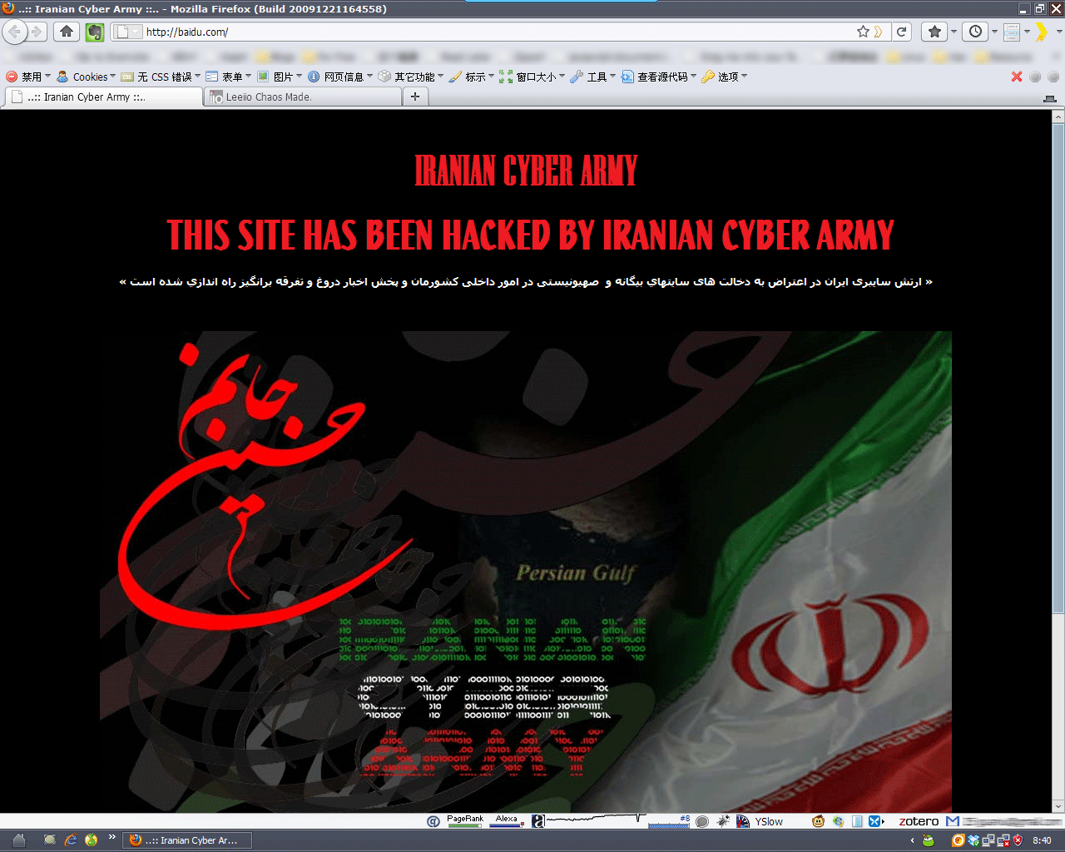
Operation Aurora (12 janvier 2010)
Une faille « poste de travail » qui a affecté le plus important « Nuage »

Slide 5




La proposition Trend Micro
1
2
3
Sécurité
depuis
le Cloud
Sécurité
pour
le Cloud
Sécurité
dans
le Cloud
Smart Protection Network
SecureCloud
Deep Security

Slide 6

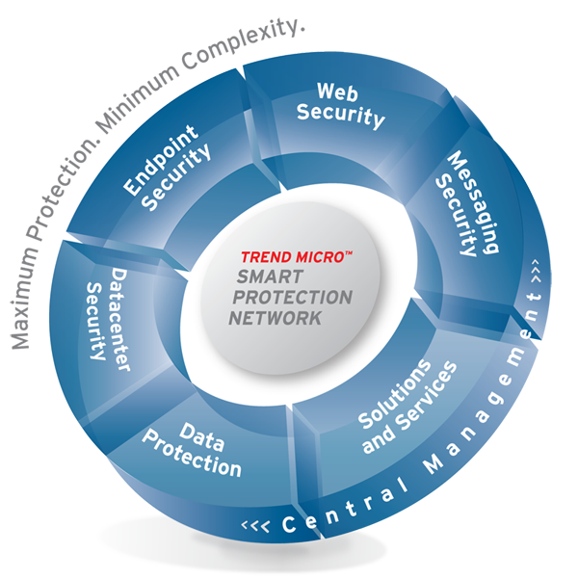





La Sécurité depuis le Cloud
“Powered by” the Smart Protection Network
EMAIL THREATS
Email Reputation
WEBSITE THREATS
Threat Correlation,
Feedback Loops, Analysis
Web Reputation
File Reputation
FILE THREATS
Trend Micro
Enterprise Security
Stopper les menaces avant qu’elles ne gagnent le Système d’Information
6
Notes:
6
Trend Micro Enterprise Security products and services are powered by Trend Micro Smart Protection Network—a next-generation cloud-client infrastructure that combines sophisticated cloud-based technology, feedback loops, and the expertise of Trend Labs researchers to deliver real-time protection from emerging threats.
The Smart Protection Network continuously evaluates and correlates threat and reputation intelligence for websites, email sources and files, enabling Trend Micro Enterprise Security solutions to block threats at the source, before they reach your network and can damage your business. You get the best in real-time threat protection without the delays, higher risks, and management complexity of conventional signature-based security products.
(build - next slide)

Slide 7



Smart Protection Network contre les Botnets
Many clients’ processes are dropping similar filenames in a short time
Community Intelligence
Many clients access or modify the same system file in a short time
Many clients accessed similar/same registry keys in a short time
Incident
Trigger
Customer
Feedback Log
File
Reputation
Correlation
Web
Reputation
Monitor
Smart Protection Network
Immediate
Protection
Correlate to figure
out where the threat
come from & where
it would connect to
Email
Reputation
File | Score | From | Connect to
Crypt.NS.Gen | X | 129.24.11.3/aexjiire/ | Euwl.tsst.com:88/e34jg/
Dropper.Gen | X | Ndj.sexadult.com/ssr/ee | 112.42.5.112:80/
Nqe.exe | V | www.xyz.com | www.abc.com
Conflicker_D | X | qd.wqwwor.com/om | nadasm0.info:80/bugsy
Conflicker_D | X | Fdjhg.wopqfe.com | 7f7fewf.cn:80/sina/
Notes:
7
7

Slide 8
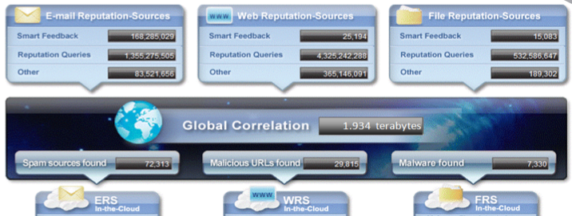
Pourquoi sommes-nous différents ?
Pourquoi notre solution est-elle efficace contre les vraies menaces ?
ERS
295 Go / jour
WRS
1305 Go / jour
FRS
334 Go / jour
2005
2006
2008

Slide 9






Sécurité du Cloud
SecureCloud permet la protection de services hébergés dans un « nuage » publique
Corporate Datacenter
Cloud Service Provider
Trend Micro
Cloud Security
Enterprise Console
VM
Corporate
APP
Hypervisor
Corporate Key
Shared
Storage
My
Corporate Data
Protection d’un Cloud public

Slide 10






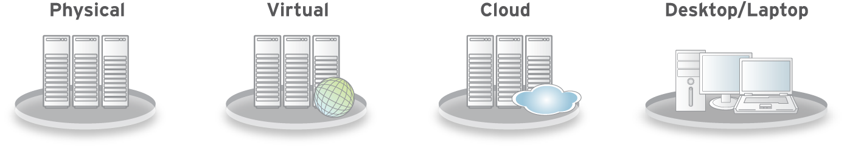

Sécurité dans le Cloud
Deep Security permet la protection de systèmes dans un Cloud grâce à 5 modules
Deep Packet Inspection
IDS / IPS
Web Application Protection
Application Control
Firewall
Integrity
Monitoring
Log
Inspection
Anti-Virus

Slide 11
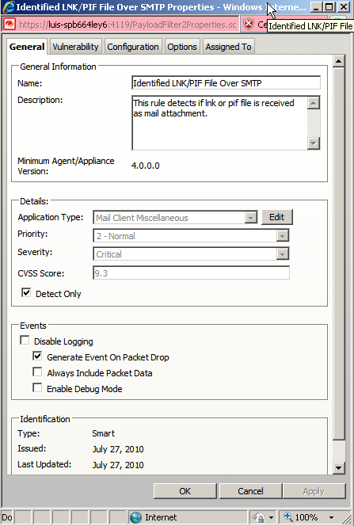

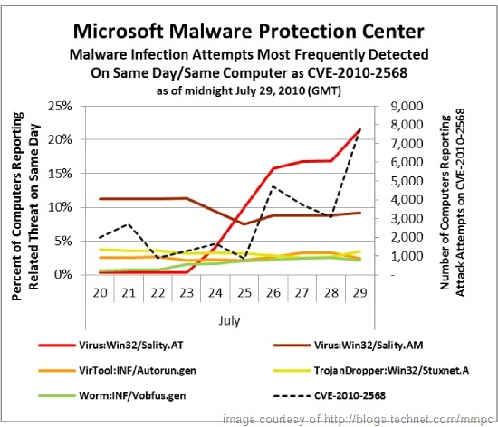
Scada et protection depuis le Cloud
« Virtual Patching » pour protéger les systèmes d’un réseau Scada
Stuxnet

Slide 12
Merci à tous

